Slide 1



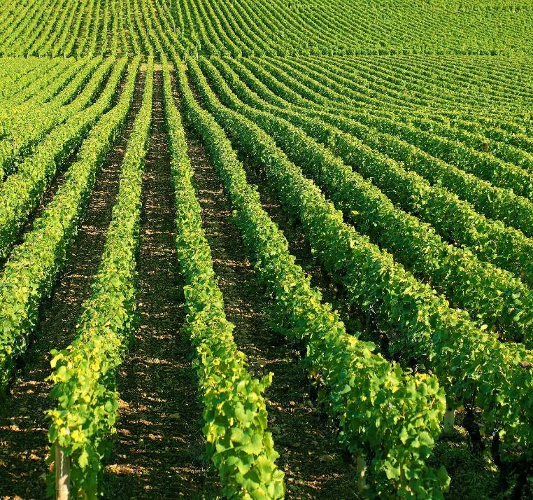
Project Work-2
Course Code: CS3PC02
B.Tech - CSE
Eight Semester
KRISHIDISHA: REVOLUTIONIZING AGRICULTURE WITH INTELLIGENT RECOMMENDATIONS, DISEASE DETECTION, AND YIELD PREDICTION
Presented by :-
Abhishek Chourasia (EN23CS3T1013)
Guide Name :-
Prof Priyanka Dhasal & Radha Yadav
Goutam Mandloi (EN23CS3T1016)
CSE Department
Shivpratap Singh Panwar (EN23CS3T1017)

Slide 2
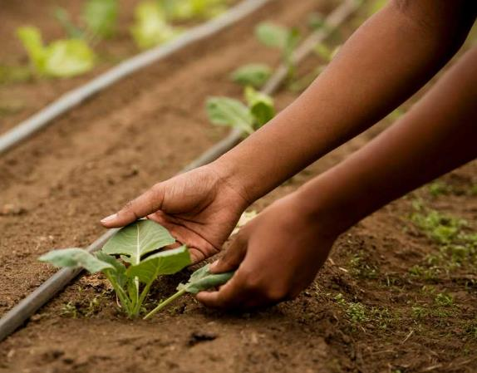

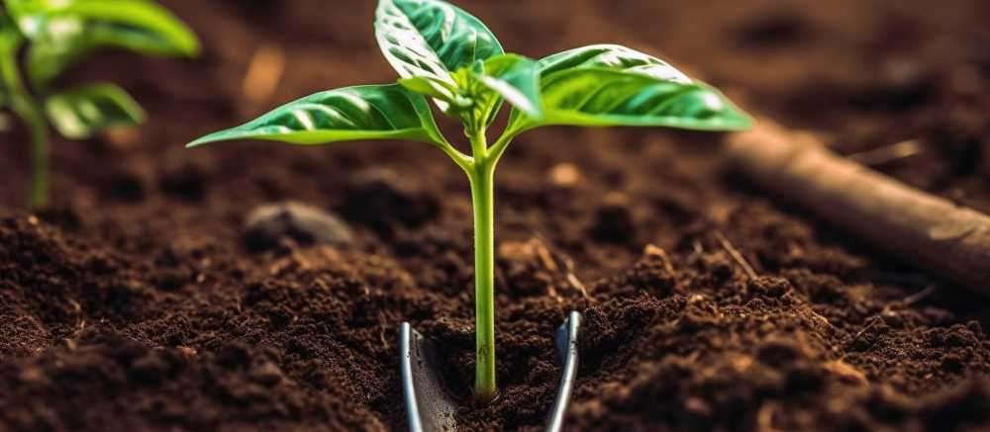
INTRODUCTION
LITERATURE REVIEW
PROBLEM DEFINITION
OBJECTIVES
Contents :-
TOOLS AND TECHNOLOGY
METHODOLOGY
CONCLUSION
REFERENCES

Slide 3
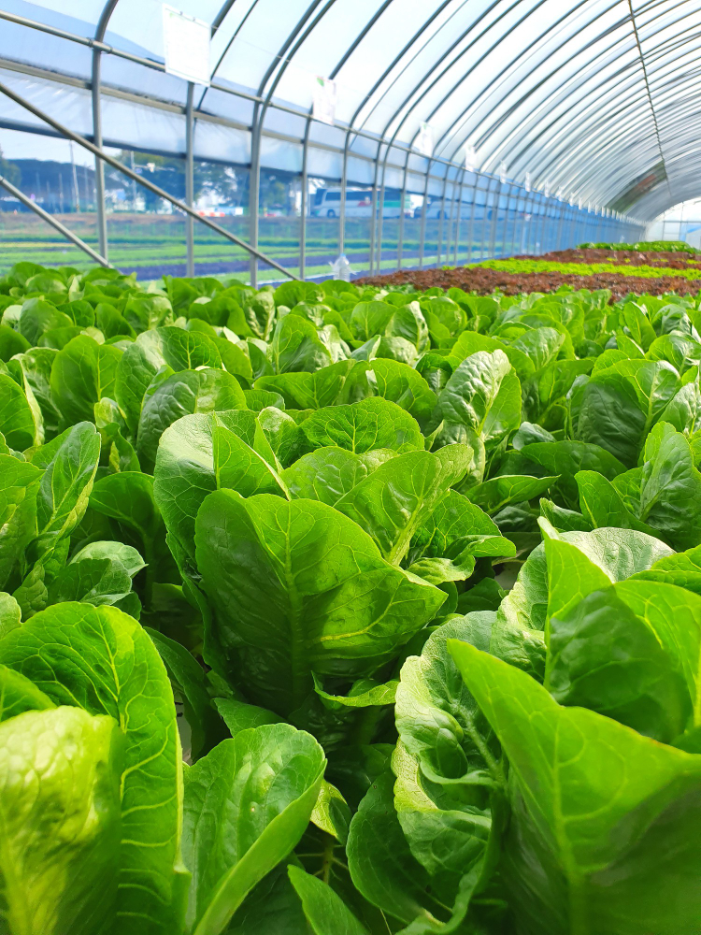

Introduction
Agricultural Importance & Challenges: Agriculture provides food security, employment, and raw materials globally. Challenges include unpredictable weather, soil degradation, pest outbreaks, and inefficient resource use. Innovative technology is essential for sustaining productivity and environmental health.
Technological Advancements: The Fourth Industrial Revolution introduces ML and DL to agriculture. These technologies enable analysis of complex data, accurate predictions, and actionable insights. ML/DL support yield prediction, disease detection, and nutrient management.
KrishiDisha: A Holistic Solution: Integrates crop recommendations, fertilizer optimization, disease detection, and yield prediction into one platform.

Slide 4
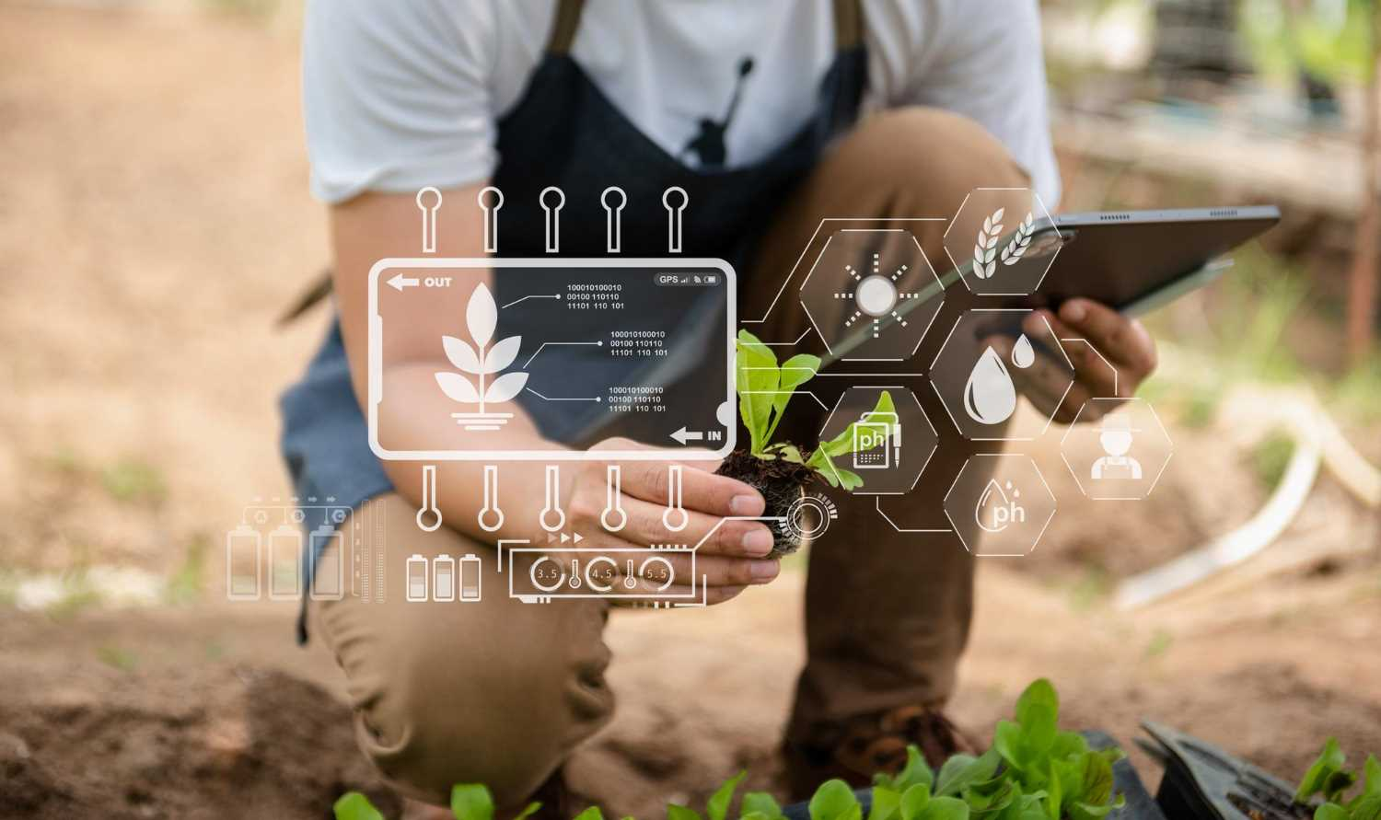
Literature Review
Recent studies in precision agriculture highlight the transformative impact of AI in addressing key challenges. In crop recommendation, Kumar et al. [1] used a Random Forest model on the Crop_recommendation.csv dataset to achieve around 96% accuracy by emphasizing feature importance and interpretability. In contrast, our approach integrates an ensemble of models (SVM, Gradient Boosting, Extra Trees, etc.) to reach accuracies up to 99.3%, providing more robust recommendations.
For fertilizer optimization, Gupta et al. [2] demonstrated high accuracy using decision tree algorithms on Fertilizer Prediction.csv. Building on this, subsequent research [3], [4] showed that ensemble methods and gradient boosting further enhance performance by balancing overfitting and generalization. Our system leverages multiple algorithms to deliver comprehensive fertilizer guidance.
Crop yield prediction has also advanced through AI. Das et al. [5] compared various regression models using crop yield data and found that gradient boosting, when finely tuned, delivers excellent performance. Our optimized gradient boosting regressor achieves a Test R² of 0.9793, underscoring its reliability in real-world scenarios.
In the domain of crop disease detection, Ferentinos [6] demonstrated that deep CNNs trained on the Plant Village dataset can achieve over 95% accuracy. Our custom-designed CNN architecture, tailored to diverse image conditions, integrates into the KrishiDisha platform to provide rapid and accurate disease diagnosis.

Slide 5
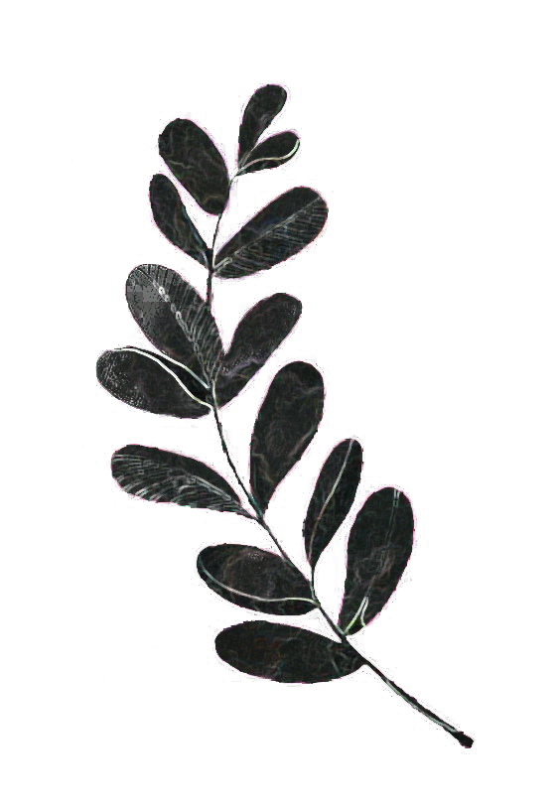
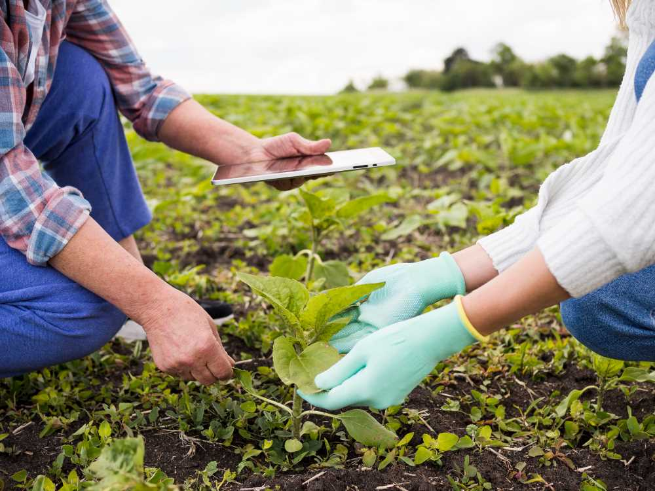

Problem Definition
Lack of Personalized Recommendations: Generic advice fails to account for specific factors like soil type, climate, and nutrient levels, leading to inefficiencies and reduced yields.
Delayed Disease Identification: Manual inspection results in slow detection, allowing diseases to spread and cause significant crop losses.
Inaccurate Yield Prediction: Without precise forecasting tools, farmers struggle to efficiently allocate resources and plan crop cycles.
Limited Access to Technology: Farmers in remote areas often lack access to modern agricultural tools, expert guidance, and timely insights.
KrishiDisha's Integrated Solution: Combines AI and ML to provide personalized recommendations, real-time disease detection, and accurate yield prediction, empowering farmers for sustainable and profitable farming.

Slide 6

Objectives
Accurate Recommendations
Real-Time Disease Detection
Utilize Random Forest to provide crop and fertilizer advice based on specific farm conditions like soil composition, temperature, humidity, and rainfall.
Employ CNNs to detect crop diseases through image analysis for prompt intervention.
Precise Yield Prediction
User-Friendly Multilingual Interface
Use Gradient Boosting Regressor to forecast yields accurately based on environmental factors, crop type, and historical data.
Develop an intuitive platform with support for Hindi, Tamil, Telugu, Punjabi, Kannada, and English.
Sustainable Resource Optimization
Integrated Holistic Solution
Optimize fertilizer use and resource allocation to maximize productivity and minimize environmental impact.
Combine crop recommendations, fertilizer guidance, disease detection, and yield prediction into one platform.
Scalability and Adaptability
Rural Accessibility
Design the system to evolve with new crops, diseases, and datasets as agricultural needs change.
Ensure mobile accessibility and real-time insights for farmers in remote areas.

Slide 7
Tools and Technology
Front-End Technologies
Back-End Technologies
Machine Learning Tools
HTML: Structures web pages for farmer and admin interactions (forms, tables, text).
CSS: Styles pages for an attractive, responsive UI across devices.
JavaScript: Adds dynamic functionality for user interactions and form validation
Flask Lightweight Python framework for handling API requests and integrating ML models.
Python Core language for back-end logic and implementing ML models (Random Forest, GBR, CNN).
MySQL Relational database to store farmer details, activities, and admin data.
SQLAlchemy Python ORM for simplified, secure database interactions.
Scikit-Learn: Builds ML models for crop and fertilizer recommendations.
TensorFlow/Keras Develops and trains CNN models for crop disease detection.
LabelEncoder Converts categorical data into numeric format for ML.
Jupyter Notebook/Google Colab Interactive platforms for prototyping, training, and visualizing models.
External Data Sources
Kaggle: Provides crop disease image datasets for training the CNN.
Image Processing
Development & Deployment Tools
OpenCV: Pre-processes crop images to enhance quality before CNN classification.
VS Code: IDE for coding in Python, HTML, CSS, and JavaScript with integrated terminal and Git support. Flask App Deployment Deployed locally or on cloud platforms (AWS, Heroku) for public access.

Slide 8
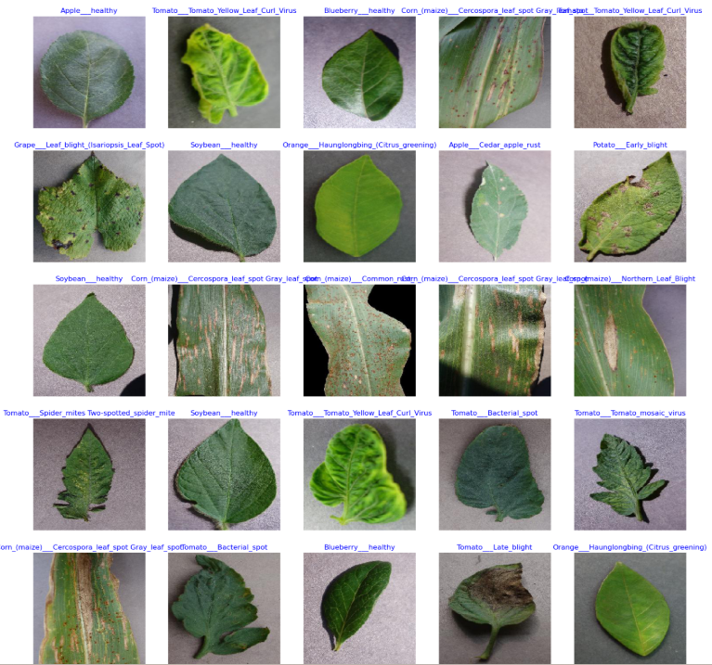
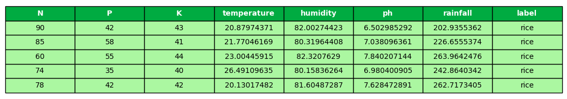
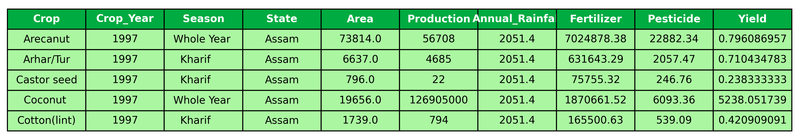
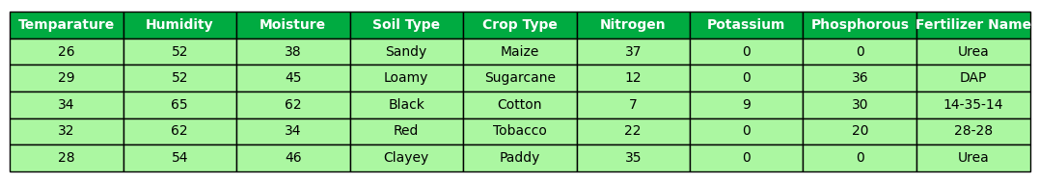
Dataset
Crop Disease Detection Dataset
Crop Recommendation Dataset
Crop Yield Dataset
Fertilizer Recommendation Dataset

Slide 9
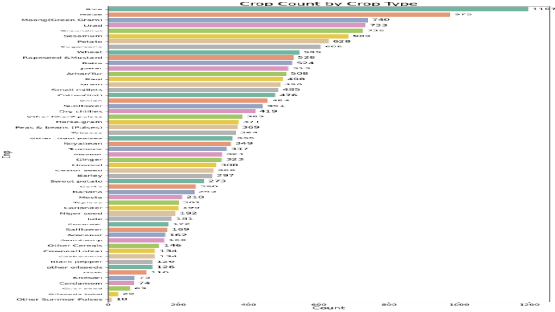
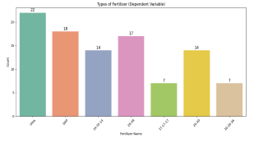
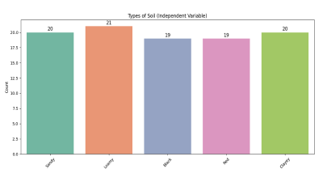
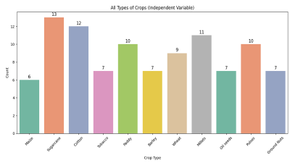

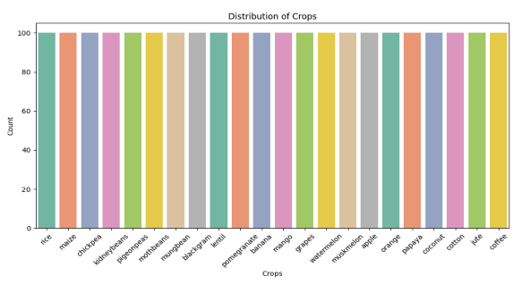
Data Visualization

Slide 10


Slide 11
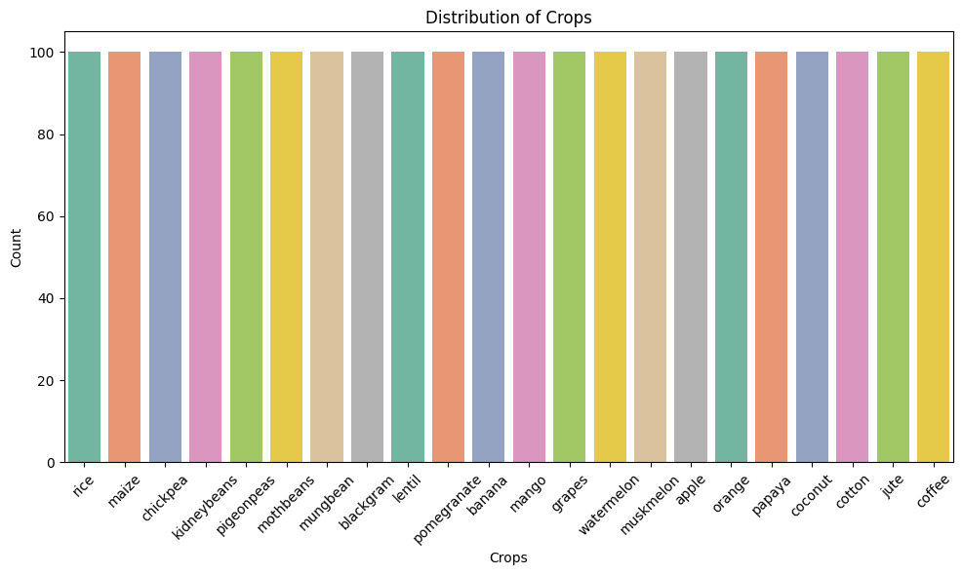

Slide 12
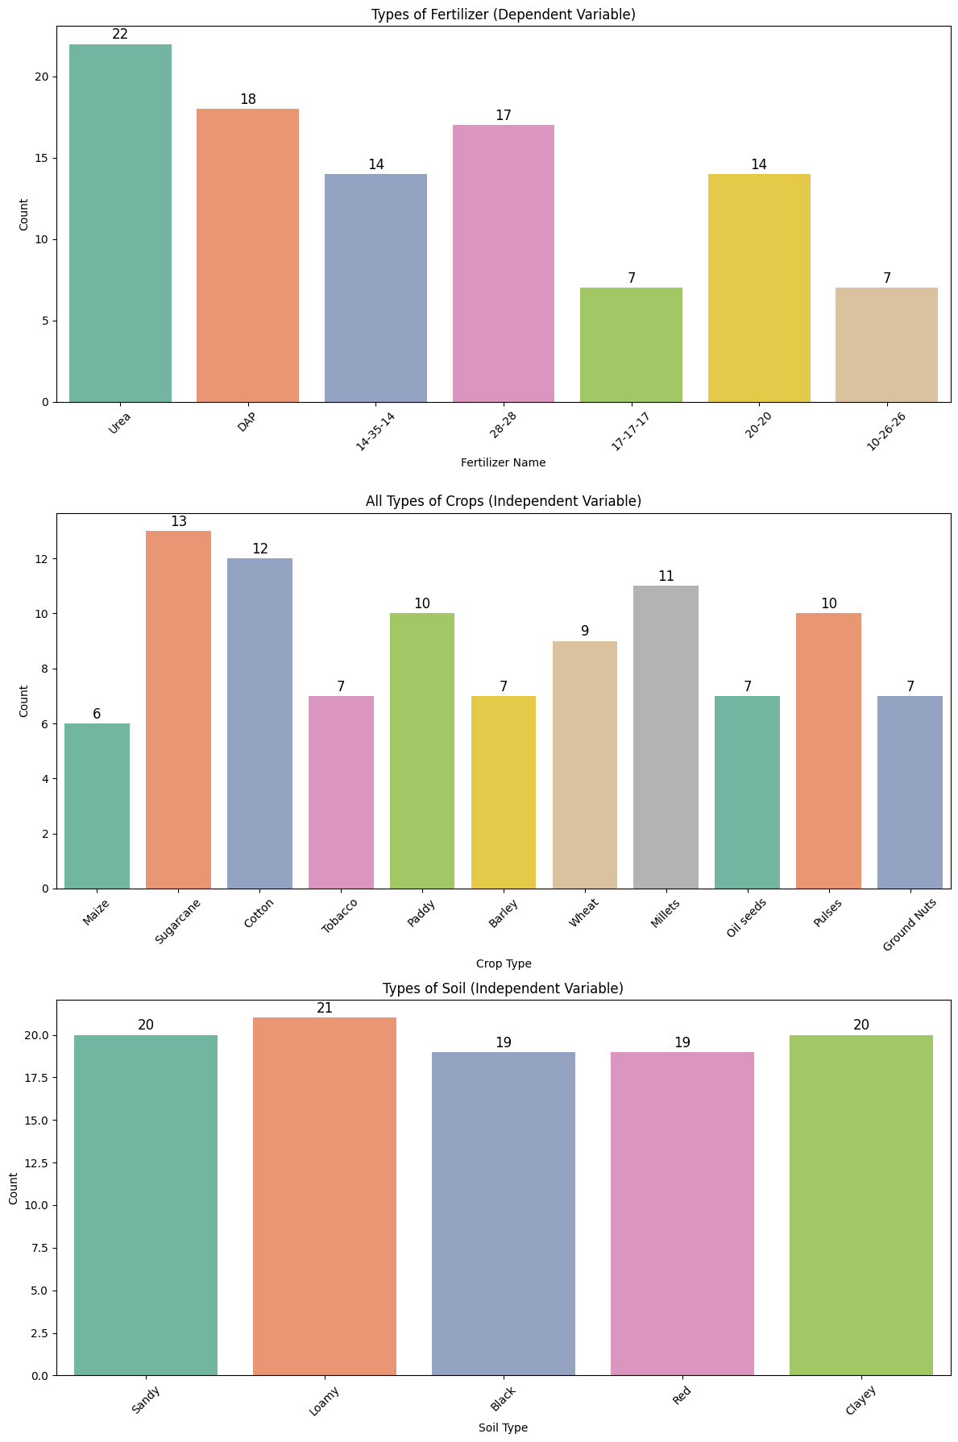

Slide 15
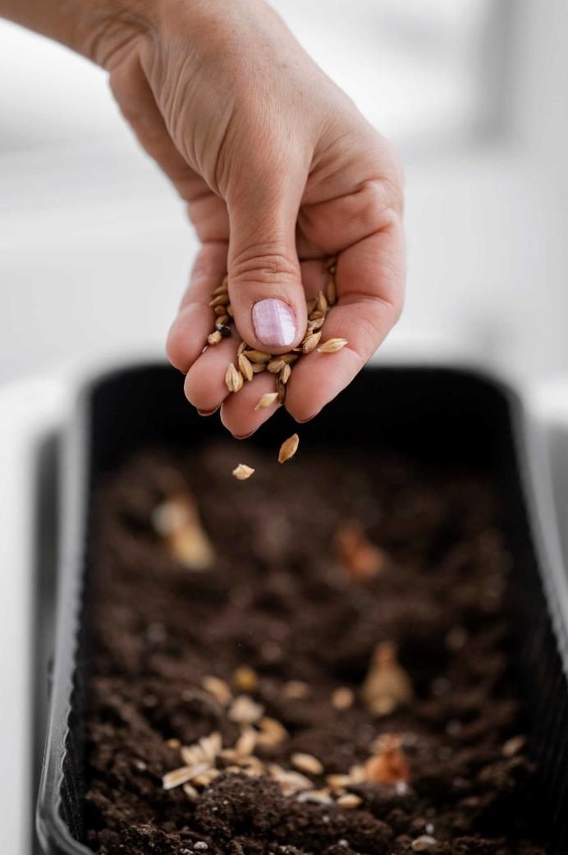
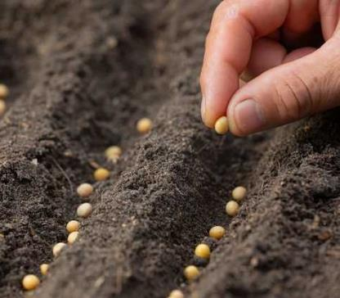
Methodology
User Registration & Verification: Farmers register with hashed passwords stored in MySQL. Admin verifies registrations via a dashboard.
Farmer Portal: Home & Dashboards Central access to crop recommendations, fertilizer suggestions, yield prediction, and disease detection. Crop Recommendation Farmers input parameters (N, P, K, temperature, humidity, pH, rainfall) for crop suggestions via ML models. Fertilizer Recommendation Multiple classifiers process soil and crop data (N, P, K, temperature, humidity, moisture, crop type, soil type) for optimal fertilizer suggestions.
Disease Detection Crop images are analyzed by a CNN to classify diseases and recommend treatments. Yield Prediction An MLPnCNN model forecasts yields using historical and environmental data. Supplement Store & Activity Reports Features for purchasing supplements and downloading detailed reports. Multilingual Support Google Translate API integration for regional language access.
Admin Dashboard: Provides CRUD operations and verifies farmer registrations, ensuring data integrity
Machine Learning Pipeline: Data Preprocessing Uniform categorical encoding and scaling.
Model Training & Evaluation Models assessed using AUC, accuracy, F1 score, precision, MSE, and MAE. Deployment Trained models are saved as pipelines and seamlessly integrated with the Flask application.

Slide 16
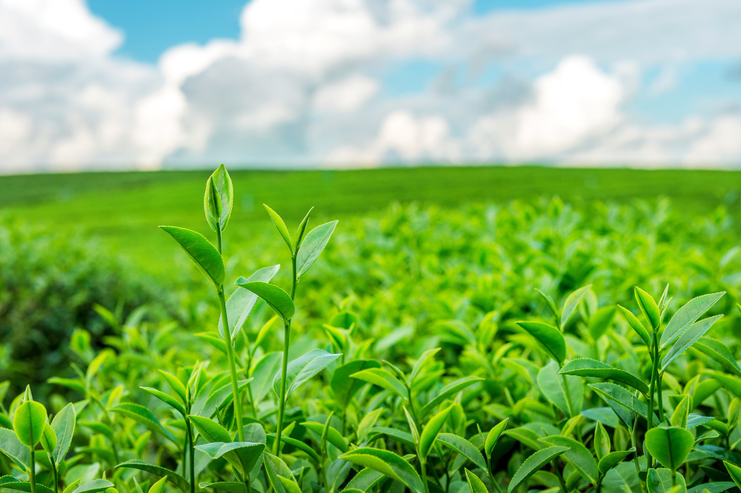
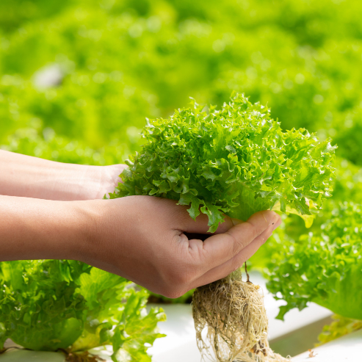
Conclusion
KrishiDisha demonstrates that an integrated approach—combining robust ML and DL models with an accessible web interface—can significantly enhance decision support for modern agriculture. Compared with existing research, our platform not only achieves competitive or superior performance on each individual module but also provides a unified ecosystem for farmers. Future work will focus on incorporating additional data sources (e.g., remote sensing) and further optimizing the deep learning architectures to address evolving challenges in precision agriculture.

Slide 17
References
[1] A. Kumar et al., "Crop Recommendation System using Random Forest," in Proc. IEEE Conf. on Precision Agriculture, 2020.
[2] F. Gupta et al., "Fertilizer Recommendation System using Decision Tree Algorithms," IEEE Access, vol. 7, pp. 111234–111245, 2019.
[3] G. Verma et al., "Intelligent Fertilizer Recommendation using Gradient Boosting," in Proc. IEEE AgriTech Conference, 2020.
[4] H. Mehta et al., "A Comparative Analysis of Machine Learning Models for Fertilizer Prediction," in Proc. Smart Farming Tech, 2021.
[5] K. Das et al., "Crop Yield Prediction using Machine Learning: A Comparative Study," in Proc. Int. Conf. Agric. Data Science, 2019.
[6] P. Ferentinos, "Deep Convolutional Neural Networks for Plant Disease Detection," Comput. Electron. Agric., vol. 145, pp. 311–318, 2018.

Slide 18
Project Work-2
Course Code: CS3PC02
B.Tech - CSE
Eight Semester
KRISHIDISHA: REVOLUTIONIZING AGRICULTURE WITH INTELLIGENT RECOMMENDATIONS, DISEASE DETECTION, AND YIELD PREDICTION
Presented by :-
Abhishek Chourasia (EN23CS3T1013)
Guide Name :-
Prof Priyanka Dhasal & Radha Yadav
Goutam Mandloi (EN23CS3T1016)
CSE Department
Shivpratap Singh Panwar (EN23CS3T1017)

